Slide 1

ML using Python Session 4
Nabajyoti Pathak
Data Scientist,

Slide 2
Topics to be covered
Introduction to regression
Regularized Regression
Auto Selection of Parameters
Evaluation of best method

Slide 3
Introduction to regression
Linear regression is the simplest and most widely used statistical technique for predictive modeling.
It basically gives us an equation, where we have our features as independent variables, on which our target variable is dependent upon.

Slide 4

What does the equation look like?
Linear regression equation looks like this:
Here, we have Y as our dependent variable (Sales), X’s are the independent variables and all thetas are the coefficients. Coefficients are basically the weights assigned to the features, based on their importance.

Slide 5
Example –Importance of Coefficient
If we believe that sales of an item would have
higher dependency upon the type of location as
compared to size of store, it means that sales in
a tier 1 city would be more even if it is a smaller
outlet than a tier 3 city in a bigger outlet.
Therefore, coefficient of location type would be
more than that of store size.

Slide 6

Simple Linear Regression
Linear regression with only one feature, i.e., only one independent variable. Therefore our equation becomes
This equation is called a simple linear regression equation, which represents a straight line, where ‘Θ0’ is the intercept, ‘Θ₁’ is the slope of the line.

Slide 7
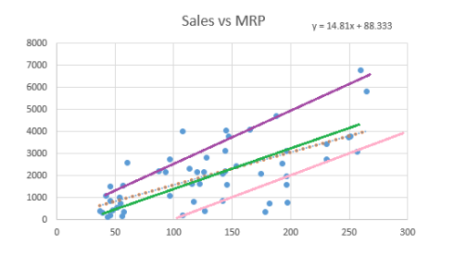
Thinking!!!!!
So how would you choose the best fit line or the regression line?

Slide 8
The Line of Best Fit
The main purpose of the best fit line is that our predicted values should be closer to our actual or the observed values, because there is no point in predicting values which are far away from the real values.
We tend to minimize the difference between the values predicted by us and the observed values, and which is actually termed as error.

Slide 9
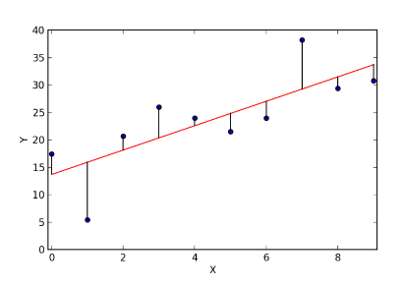
Errors
Graphical representation of error is as shown below.
These errors are also called as residuals.
The residuals are indicated by the vertical lines showing the difference between the predicted and actual value

Slide 10
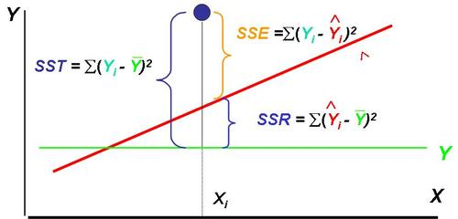
SST, SSE, SSR

Slide 11
Calculating SSR
Population mean: y
Dependent variable
Independent variable (x)
The Sum of Squares Regression (SSR) is the sum of the squared differences between the prediction for each observation and the population mean.

Slide 12
REGRESSION FORMULAS
The Total Sum of Squares (SST) is equal to SSR + SSE.
Mathematically,
SSR = ∑ ( y – y ) (measure of explained variation)
SSE = ∑ ( y – y ) (measure of unexplained variation)
SST = SSR + SSE = ∑ ( y – y ) (measure of total variation in y)

Slide 13

Mean squared error (MSE)
In statistics, the mean squared error (MSE) or mean squared deviation (MSD) of an estimator (of a procedure for estimating an unobserved quantity) measures the average of the squares of the errors—that is, the average squared difference between the estimated values and what is estimated.

Slide 14
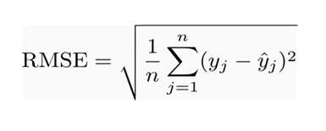
Root mean squared error (RMSE)
RMSE is a quadratic scoring rule that also measures the average magnitude of the error.
It’s the square root of the average of squared differences between prediction and actual observation.

Slide 15

The Coefficient of Determination(R-square)
The proportion of total variation (SST) that is explained by the regression (SSR) is known as the Coefficient of Determination, and is often referred to as R .
The value of R can range between 0 and 1, and the higher its value the more accurate the regression model is. It is often referred to as a percentage.

Slide 16

Adjusted R-square
The only drawback of R² is that if new predictors (X) are added to our model, R² only increases or remains constant but it never decreases. We can not judge that by increasing complexity of our model, are we making it more accurate?
The Adjusted R-Square is the modified form of R-Square that has been adjusted for the number of predictors in the model. It incorporates model’s degree of freedom.
The adjusted R-Square only increases if the new term improves the model accuracy.
N= number of rows
P= number of feature/columns

Slide 17

Gradient Descent
Gradient descent algorithm’s main objective is to minimize the cost function.
It is one of the best optimization algorithms to minimize errors (difference of actual value and predicted value).
Let’s represent the hypothesis h, which is function or a learning .
The goal is similar like the above operation that we did to find out a best fit of intercept line ‘y’ in the slope ‘m’. Using Gradient descent algorithm also, we will figure out a minimal cost function by applying various parameters

Slide 18

Gradient Descent Algorithm
Suppose you are at the top of a mountain, and you have to reach a lake which is at the lowest point of the mountain (a.k.a valley). A twist is that you are blindfolded and you have zero visibility to see where you are headed. So, what approach will you take to reach the lake?

Slide 19
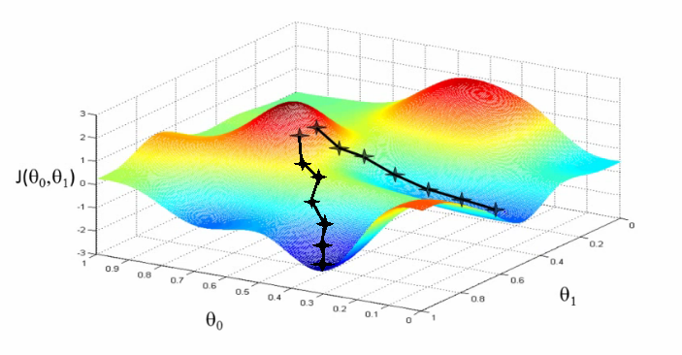
Gradient Descent
The best way is to check the ground near you and observe where the land tends to descend. This will give an idea in what direction you should take your first step. If you follow the descending path, it is very likely you would reach the lake.

Slide 20
Gradient Descent
Suppose we want to find out the best parameters (θ1) and (θ2) for our learning algorithm. Similar to the analogy above, we see we find similar mountains and valleys when we plot our “cost space”. Cost space is nothing but how our algorithm would perform when we choose a particular value for a parameter.
So on the y-axis, we have the cost J(θ) against our parameters θ1 and θ2 on x-axis and z-axis respectively. Here, hills are represented by red region, which have high cost, and valleys are represented by blue region, which have low cost.

Slide 21
Gradient Descent
There are three types of Gradient Descent Algorithms:
1. Batch Gradient Descent 2. Stochastic Gradient Descent 3. Mini-Batch Gradient Descent

Slide 22
Batch Gradient Descent
In the batch gradient descent, to calculate the gradient of the cost function, we need to sum all training examples for each steps
If we have 3 millions samples (m training examples) then the gradient descent algorithm should sum 3 millions samples for every epoch. To move a single step, we have to calculate each with 3 million times!
Batch Gradient Descent is not good fit for large datasets

Slide 23
Stochastic Gradient Descent (SGD)
In stochastic Gradient Descent, we use one example or one training sample at each iteration instead of using whole dataset to sum all for every steps
SGD is widely used for larger dataset trainings and computationally faster and can be trained in parallel
Need to randomly shuffle the training examples before calculating it

Slide 24
Mini-Batch Gradient Descent
It is similar like SGD, it uses n samples instead of 1 at each iteration.

Slide 25
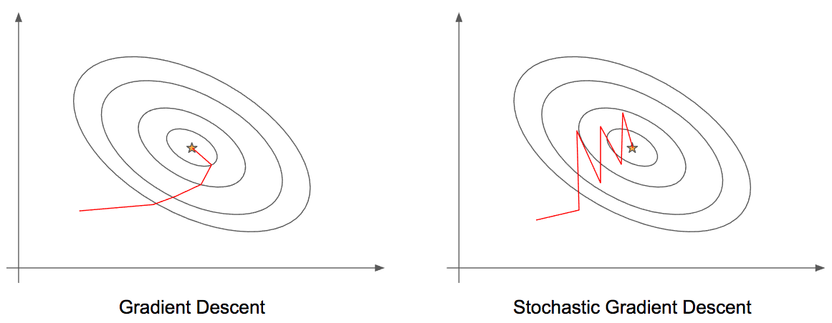
Gradient Descent vs Stochastic Gradient Descent
While in GD, you have to run through ALL the samples in your training set to do a single update for a parameter in a particular iteration, in SGD, on the other hand, you use ONLY ONE or SUBSET of training sample from your training set to do the update for a parameter in a particular iteration.
If you use SUBSET, it is called Minibatch Stochastic gradient Descent.
SGD often converges much faster compared to GD but the error function is not as well minimized as in the case of GD.

Slide 26
Multiple Linear Regression
More than one independent variable can be used to explain variance in the dependent variable, as long as they are not linearly related.
A multiple regression takes the form:
y = A + β X + β X + … + β k Xk + ε
where k is the number of variables, or parameters.

Slide 27
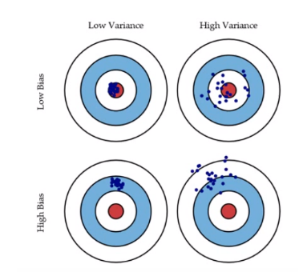
Bias and Variance in regression models
What does that bias and variance actually mean?

Slide 28
Bias and Variance
Let’s say we have model which is very accurate, therefore the error of our model will be low, meaning a low bias and low variance as shown in first figure.
All the data points fit within the bulls-eye. Similarly we can say that if the variance increases, the spread of our data point increases which results in less accurate prediction.
And as the bias increases the error between our predicted value and the observed values increases.

Slide 29
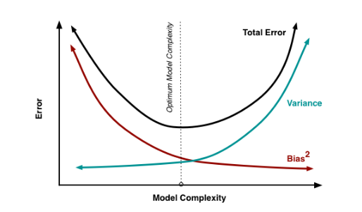
Now how this bias and variance is balanced to have a perfect model?
As we add more and more parameters to our model, its complexity increases, which results in increasing variance and decreasing bias, i.e., overfitting.
So we need to find out one optimum point in our model where the decrease in bias is equal to increase in variance.
In practice, there is no analytical way to find this point.

Slide 30
Overfitting for a regression model
To overcome underfitting or high bias, we can basically add new parameters to our model so that the model complexity increases, and thus reducing high bias.
Basically there are two methods to overcome overfitting,
Reduce the model complexity
Regularization

Slide 31
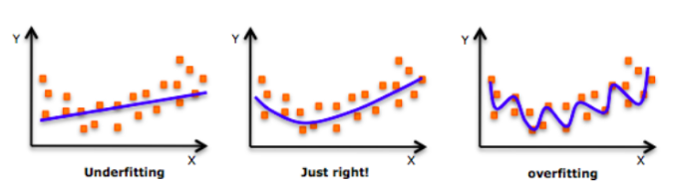
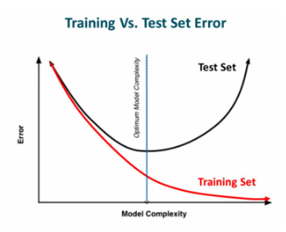
What is Regularization?

Slide 32
Regularized Regression
Regularization is a technique which makes slight
modifications to the learning algorithm such
that the model generalizes better. This in turn
improves the model’s performance on the
unseen data as well.
Ridge Regression
Lasso Regression

Slide 33
Ridge and Lasso
Ridge and Lasso regression are powerful techniques generally used for creating parsimonious models in presence of a ‘large’ number of features. Here ‘large’ can typically mean either of two things:
Large enough to enhance the tendency of a model to overfit (as low as 10 variables might cause overfitting)
Large enough to cause computational challenges. With modern systems, this situation might arise in case of millions or billions of features

Slide 34
Ridge and Lasso
Ridge and Lasso might appear to work towards a common goal, the inherent properties and practical use cases differ substantially.
They work by penalizing the magnitude of coefficients of features along with minimizing the error between predicted and actual observations. These are called ‘regularization’ techniques.
The key difference is in how they assign penalty to the coefficients
In lasso we use L1 regularization.
In ridge we use L2 regularization.

Slide 35

Ridge Regression
It shrinks the parameters, therefore it is mostly used to prevent multicollinearity.
It reduces the model complexity by coefficient shrinkage.
It uses L2 regularization technique.
λ given here, is actually denoted by alpha parameter in the ridge function.
So by changing the values of alpha, we are basically controlling the penalty term.
Higher the values of alpha, bigger is the penalty and therefore the magnitude of coefficients are reduced.

Slide 36

Lasso regression
LASSO (Least Absolute Shrinkage Selector Operator), is quite similar to ridge, but lets understand the difference them by implementing it in our big mart problem.
It uses L1 regularization technique
It is generally used when we have more number of features, because it automatically does feature selection
Here too, λ is the hypermeter, whose value is equal to the alpha in the Lasso function.

Slide 37


L1 and L2 Regularization
L1-norm loss function is also known as least absolute deviations (LAD), least absolute errors (LAE). It is basically minimizing the sum of the absolute differences (S) between the target value (Y_{i}) and the estimated values (f(x_{i})):
L2-norm loss function is also known as least squares error (LSE). It is basically minimizing the sum of the square of the differences (S) between the target value (Y_{i}) and the estimated values (f(x_{i}):

Slide 38
Thank you
Contact : madhupsgr@gmail.com

